Slide 1

Project Title –Telecom Customer Retention
MADDILA SANTHOSH KUMAR
GITUHUB LINK:
https://github.com/Santhosh939s/Telecom-Customer-Retention-project

Slide 2

PROBLEM STATEMENT
To predict whether a telecom customer is likely to churn based on service they get

Slide 3
Project Description
I want to build a predictive model to check whether the customer is going to leave our service or not

Slide 4

WHO ARE THE END USERS?
Telecom Customer retention team
Customer service managers
Business analyst

Slide 5

Technology Used
Google colab
Scikt learn
python
NumPy
Pandas
Matplotlib

Slide 6
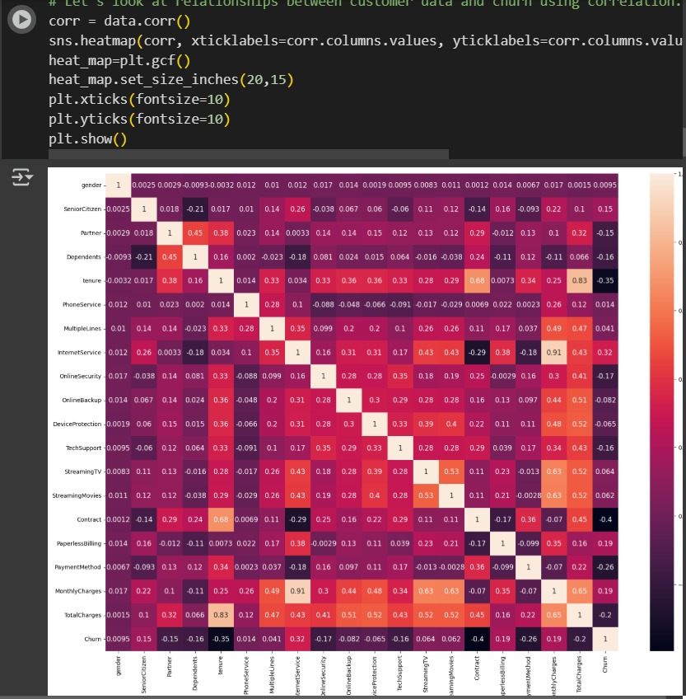
RESULTS

Slide 7
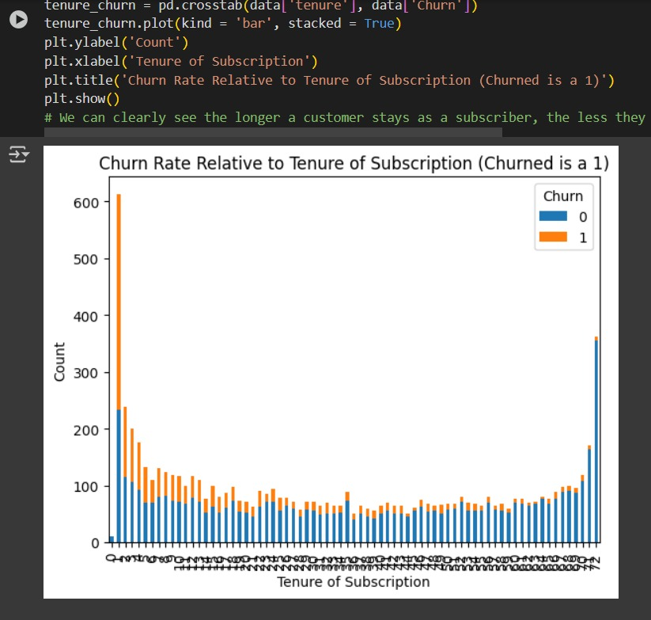
RESULTS

Slide 8
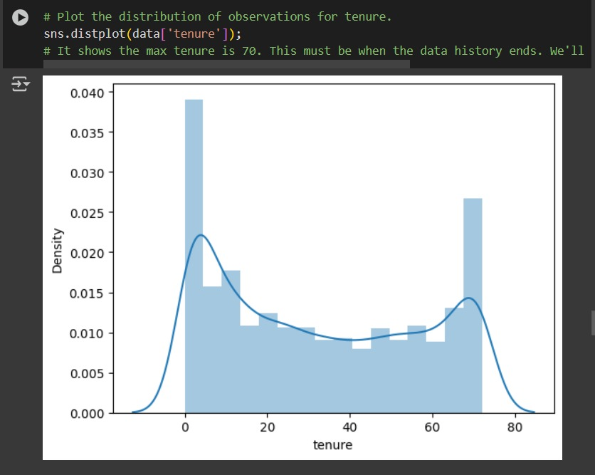
RESULTS

Slide 9
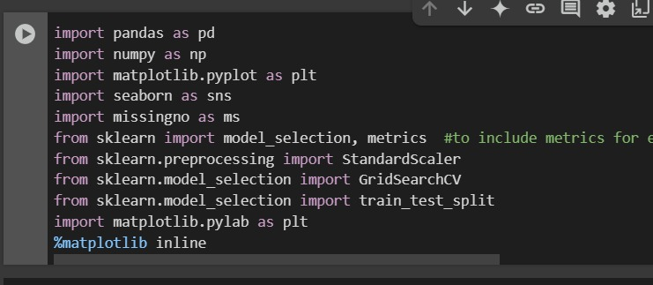
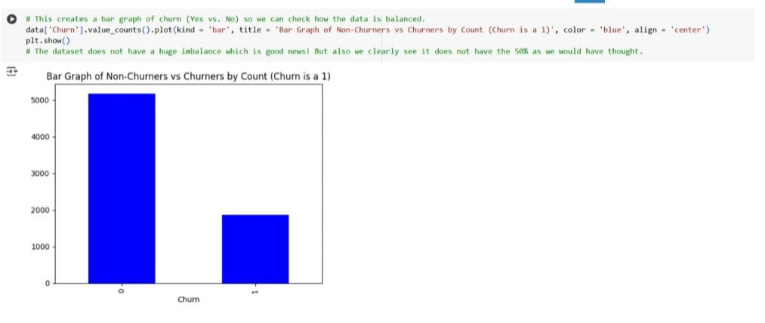
RESULTS

Slide 10
Thank you
.
.

